Slide 1



BiblioTrack
Smart Library Management System
A web-based library system for managing books, digital resources, students and library services.
PROJECT TEAM
SUPERVISION
Sir Javed Iqbal
Syeda Dilawaiz (92-B)
Javaidiq@uop.edu.pk
Haneef Ur Rahman (189-D)
Department of Computer Science, University of Peshawar

Slide 2

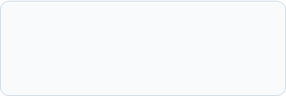

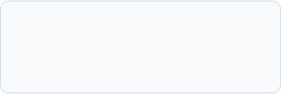
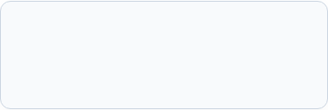
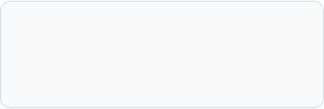
Presentation Outline
1. Introduction & Problem Solution
2. Requirements
Functional needs & Use Case flow.
CS department issues & solution.
3. Main Features
4. System Design
Admin, Student & Digital Library.
ERD schema, 3-tier design & AI.
5. Technology & Testing
6. Live Demo & Q&A
MERN stack, testing & server setup.
Live walkthrough and discussion.

Slide 3


Introduction
BiblioTrack – web-based Library Management System for CS Dept, University of Peshawar.
Modernizes the traditional library via a unified digital platform for students and admins.
Provides role-based portals to improve accessibility, automation, and efficiency.
Built as a scalable web application for current and future needs.

Slide 4


Problem & Proposed Solution
CS Department Library Lacks:
What We Built (BiblioTrack):
No Digital Resource Management: No single online place for notes & books.
Web-Based Digital Library: Centralized system for the CS department.
No Smart Search: Manual book search causes too much time.
Physical Book Management: Track all books, issues, and returns.
No Instant Assistance: Students have no support outside office hours.
Digital Resources (PDFs): 24/7 access to view and download study materials.
Manual Fine & Issue Tracking: Paper registers cause human record errors.
Integrated AI Student Assistant: Instant answers for all library queries.
Impact: Library work becomes inefficient in the era of modern technology.
Project Novelty: Combines physical, digital, and AI in a single platform.

Slide 5
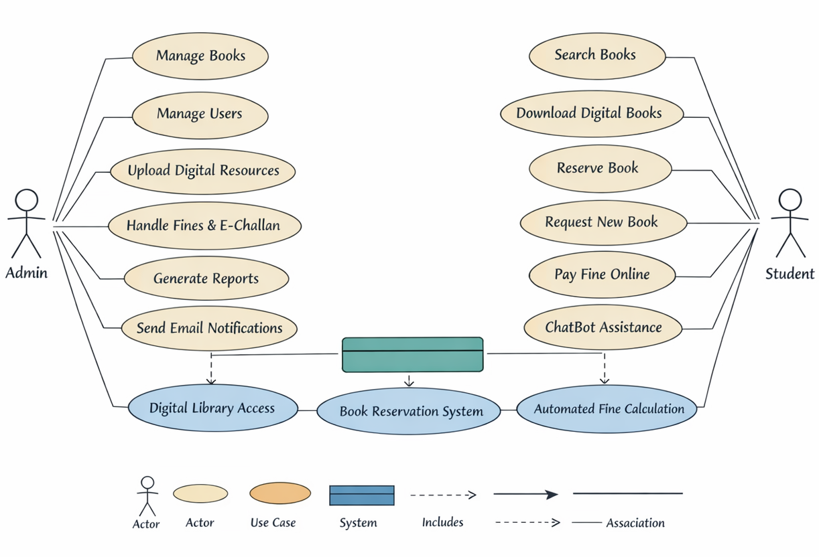

System Requirements & Use Case Overview
Requirements Analysis
User Feedback: Surveyed CS students and interviewed librarians.
Two Distinct Roles: Admin (Librarian) and Student actors.
Core Functional Modules: Book catalog, PDF repository, reservations, and fines.
Automated Rules: Automatic fine calculation upon overdue book return.
Non-Functional Goals: Quick responses, system availability and secure login.

Slide 6


Major Features: Student Panel
Physical Book Services
Digital & Smart Services
Search Physical Books: Search by title, author, or category.
Download Digital PDFs: Direct access to course slides and lecture notes.
Check Availability: Check online whether the book is available in the library.
Use AI Chatbot: Ask questions and receive instant assistance.
Request Issue: Submit an issue request through the portal.
Track Fines: See calculated fines & payment
status.
View Issued Books: Check borrowed books and their due dates.
Book Requests: Request new books for
library.

Slide 7


Major Features: Admin Panel
Books & Resource Management
Requests & Fine Handling
Add / Edit / Delete Books: Add, update, or remove physical books records.
Manage Students: Approve, view, and manage student accounts.
Upload Digital Resources: Upload PDF books and lecture notes easily.
Approve Requests: Accept or reject pending book issue requests.
Dashboard Overview: See current stats for books, users, and requests.
Fine Management: Monitor overdue fees and record 1-Bill payments (Invoice Voucher).

Slide 8

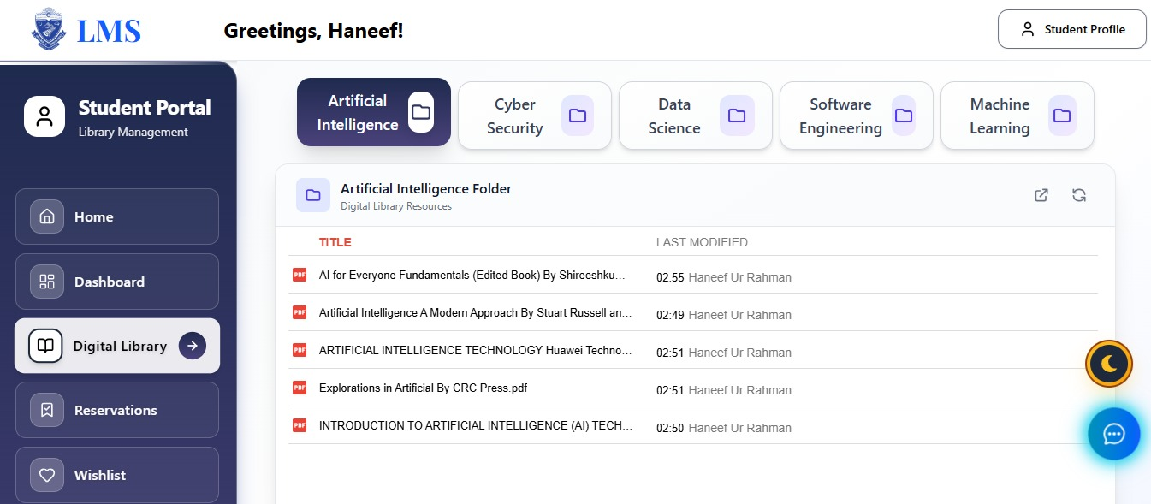
Digital Library Module
Module Capabilities
Admin PDF Uploads: Librarians upload digital copies with basic information.
Organized Structure: Resources are categorized by Subject & Category.
View & Download: Read inside browser or download for offline study
24/7 Access & No Physical Dependency: Students can read & access pdfs anytime.

Slide 9
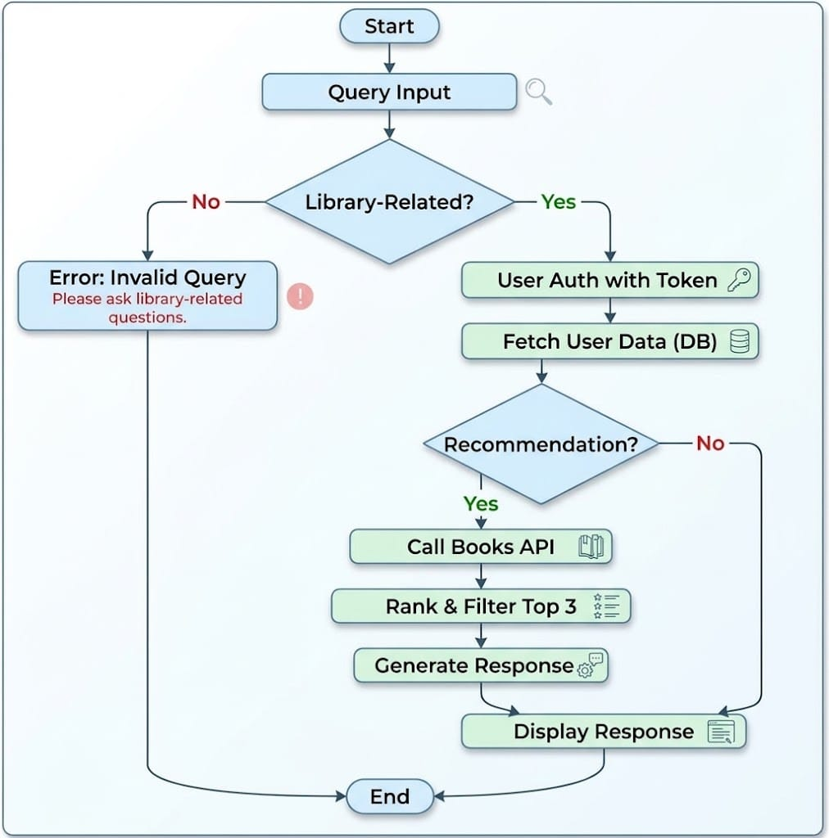

AI Chatbot - (BiblioBot) Architecture & Logic
AI Assistant Execution Flow
Intent Verification: Checks if user query is library-related.
Student Context: Verifies the user and gets their dues/loans.
Book Recommendations: Uses Google Books API to suggest top 3 books.
Dynamic Output: Uses current information to give the answer.
EXACT FALLBACK RULE (OFF-TOPIC):
"Sorry, I can only answer library-related questions."

Slide 10
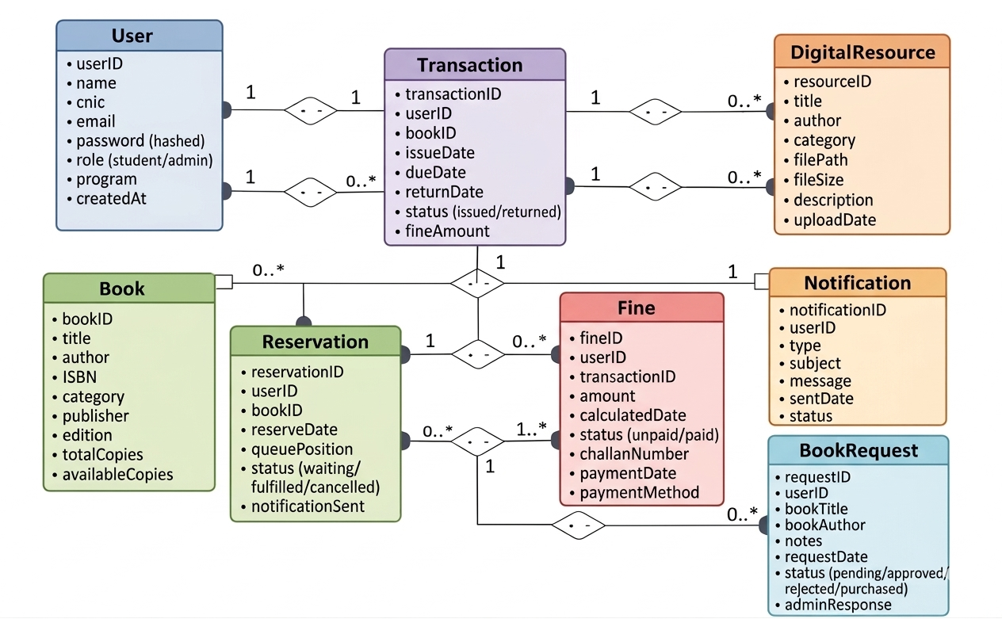
Design Details: Database Schema (ERD)
Database Schema In MongoDB
Users & Roles: Stores student and admin profiles with protected passwords.
Books & Copies: Tracks total & currently available copies.
Transactions (1:M): Connects students with book issue and return dates.
Fine & Challan (1:1): Connects fines with overdue book transactions.
Reservations & Requests: Manages waiting queues and new book requests.

Slide 11
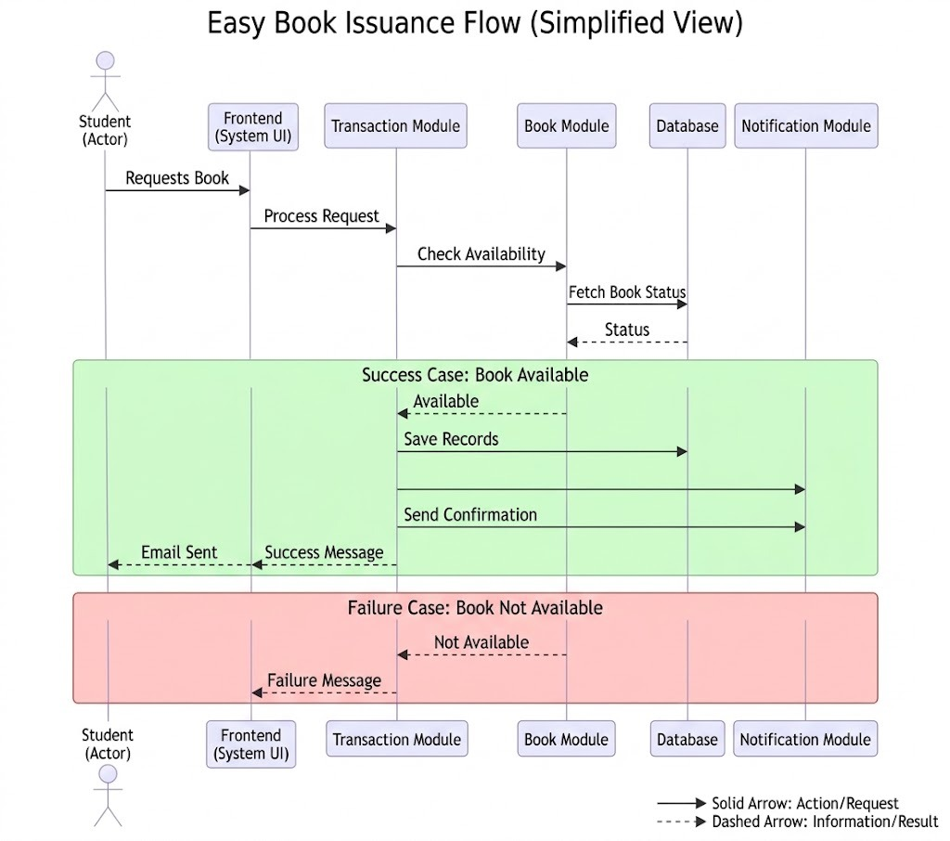
Design Details: Book Issuance Workflow
Issuance Sequence Logic
Step 1 (Request): Student requests a book through website.
Step 2 (Availability Check): System checks available copies in database.
Book Available: Creates issuance record, update stock, sends email.
Unavailable Book Reservation: If unavailable, the book is marked as reserved.
Confirmation: Student receives confirmation and dashboard shows the borrowed book.

Slide 12
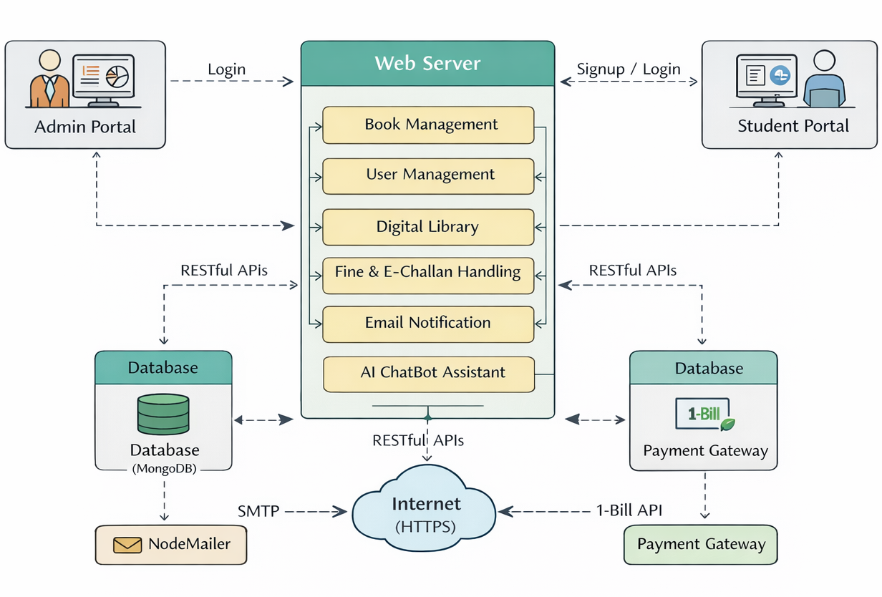
System Architecture
Architectural Layers
Frontend Layer: React-based website with responsive portals.
Web & App Server: Node.js & Express handle the main system operations.
Core Modules: Book, User, Digital Library, Fine, and Email services.
Data Layer: MongoDB database stores the system data.
External Integrations: NodeMailer (Email) & 1-Bill Payment Gateway.

Slide 13
Technology Stack
Layer | Technology | Role in BiblioTrack
Frontend | React.js & Tailwind CSS | Responsive single-page web app with interactive UI dashboards.
Client-Server Communication | Axios (REST APIs) | Secure communication between frontend & backend using JWT.
Backend Runtime | Node.js & Express.js | Handles library operations & backend requests.
Database | MongoDB & Mongoose | Stores and manages library data.
AI & External Services | Google Books API / NodeMailer | Smart book recommendations and automated emails.

Slide 14




Testing & Quality Assurance
Unit Testing
Integration Testing
Tested password hashing and JWT token expiration.
Verified full API cycle between React and Express backend.
Verified automated fine calculation accuracy.
Confirmed that approved issue requests reduce book inventory.
User Acceptance Testing (UAT)
Performance & AI Testing
Tested with CS department students and library staff.
Database response time averaged within 1.5 to 2.0 seconds.
Received positive feedback for intuitive UI and fast book search.
Chatbot (BiblioBot) reliably executed fallback rule on non-library queries.

Slide 15



Live Project Demo
BiblioTrack in Action --- Followed by Viva Q&A
We now invite our respected supervisor and honorable external examiner for the live system demonstration and questions.
BiblioTrack
Smart Library Management System
Department of Computer Science
University of Peshawar

